Slide 1
Instructor Tips

Slide 2
Relax, learn and be excited!
They only will if you do

Slide 3
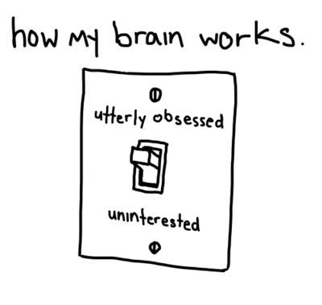
httpaedia.tumblr.com/2a8905fan9ca06e7dff8e7b5f36c6faafd/tumblr_mp9v95RXHA1soq4w2o1_400.jpg

Slide 4
Ask questions directly
Address people frequently and by name

Slide 5
Create a story
Thread disparate content with good sequence and connection

Slide 6
Move around the class
Stand by the side of the less interested

Slide 7
Start and finish with COOL STUFF
Keep the boring stuff for… never!

Slide 8
Use the whiteboard
Specially for complex, incremental explanations

Slide 9
Use the lab time
Peek the next presentation, check who's having trouble, lookup answers, take some water...

Slide 10
Prepare again and again...
Know what you will say in slide or section and what to errors expect in the labs

Slide 11
Speaker notes are for YOU
Read them and, if helpful, have them available on secondary or mobile display

Slide 12
Don't corner yourself
If you are feeling uncomfortable with any content, hide or skip it and talk to others about how to deliver it

Slide 13
Add your experience
Everybody loves cases, deeper explanations, tips, tricks & hacks.
It is also important that they perceive you as an experienced solution developer, not just content relayer.

Slide 14
Show AWS Resources
Whitepapers, Reference Architectures and Case Studies and TCO Tools can make a good answer great!

Slide 15
Use external resources
Console, Demos, Videos, Whiteboard… everything is more interesting than slides.

Slide 16
Introduce the day clearly
Review last day, present day agenda, get and set expectations, write timing and facility information.

Slide 17
Manage time carefully and explicitly
Clock your time or refer to instructors guide for each topic and set explicit lab and break times.

Slide 18
Give a break
Let people refresh attention every major or couple minor topics.

Slide 19
Questions are the best content!
- Listen fully, even if know the question
- Give precise answers first, explain after
- It is ok not to know the answer, defer and follow up
- If they do not seem to get the point, try a different angle or example
- Ask back later to verify understanding

Slide 20
Take care of the labs
- Prepare for failures, know the workarounds
- Introduce and review the exercise
- Watch for stuck students and help them through

Slide 21
Vary voice tone and volume
It is unnatural and weird to do, but that is why everyone pays attention to it.

Slide 22
Show your hands
Gestures and posture variations also helps drawing attention

Slide 23
Watch yourself
Record your presentation to kick off bad habits (swaying, playing with markers, talking to board, too loud, too soft, too “salesy”, appearance, too much or too little information when answering, caught in repetitive phrases, “umms”, vendor bashing,..)

Slide 24
Level the class
Go back to basics if they are not understanding, cut to the advanced part if they are bored

Slide 25
Take care of yourself
Alternate support feets, walk,
sit ,drink water and have a good time.

Slide 26
Videos
TED: How Great Leaders Inspire Action
TED: The Paradox of Choice

Slide 27
Articles
Why People Check Email When You're Presenting”

Slide 28
Books
Presentation ZEN
Presentation Patterns
Slide:ology

